Slide 1
Avimanyu Dartta, Ph.D.
Crafting a Deployment Strategy

Slide 2
Overview
A large part of the value of a technological innovation is determined by the degree to which people understand and use it.
An effective deployment strategy is thus a key element in a technological innovation strategy.
Some of the key elements of an effective deployment strategy include timing, licensing and compatibility, pricing, distribution, and marketing.
Notes:
Deployment is a key component of the innovation process because a new product has little value in and of itself. It is only when people understand the innovation, can access it and utilize it regularly that the product is of value. The best deployment strategies accelerate adoption by reducing uncertainty about the product and lowering resistance to switching from competing goods. Five key elements of deployment are covered in this chapter: timing, licensing and compatibility, pricing, distribution, and marketing.

Slide 3
Timing
The timing of a market launch can be an important deployment strategy
Strategic Timing of Entry
Firms can use timing of entry to take advantage of business cycle or seasonal effects
E.g., video game consoles are always launched just before Christmas.
Timing also signals customers about the generation of technology the product represents.
E.g., if too early, may not be seen as “next generation”
Timing must be coordinated with production capacity and complements availability, or launch could be weak.
Notes:
Launch Timing
Beyond the issues of timing discussed in Chapter 5, timing a product launch to take advantage of seasonal effects, or to prevent or allow cannibalization of existing products, can be an important part of a deployment strategy.
Strategic Launch Timing is a function of many factors including seasonal or business cycles and the availability of complementary goods. Video game producers typically introduce new game consoles to coincide with the Christmas shopping season, but it is essential that complementary goods (to help create demand) and sufficient production (to meet demand) are readily available when the product is introduced. For products characterized by rapid technological change, new product introductions should not follow so closely after the previous generation that consumers are reluctant to replace it, nor should the next generation be so long in coming that a competitor gets to the market first and establishes itself as the market leader.

Slide 4
Timing
Optimizing Cash Flow versus Embracing Cannibalization
Traditionally firms managed product lifecycles to optimize cash flow and return on investment → would not introduce new generation while old generation selling well.
However, in industries with increasing returns this is risky.
Often better for firm to invest in continuous innovation and willing cannibalize its own products to make it difficult for competitors to gain a technological lead.
Cannibalization: when a firm’s sales of one product (or at one location) diminish its sales of another (or another location).
Notes:
Optimizing Cash Flow versus Embracing Cannibalization is a very difficult choice for firms to make. There are instances when it is in the firm’s best interest to introduce new generations of technology while the current generation is still viable. Though this strategy will result in the new generation cannibalizing sales of the previous generation, it is more likely to keep consumers loyal to the product and prevent them from switching to another manufacturer.

Slide 5
Licensing and Compatibility
Protecting a technology too little can result in low quality complements and clones; protecting too much may impede development of complements. Firm must carefully decide:
How compatible to be with products of others
If firm is dominant, generally prefers incompatibility with others’ platforms but may use controlled licensing for complements.
If firm is at installed base disadvantage, generally prefers some compatibility with others and aggressive licensing for complements.
Whether to make product compatible with own previous generations (“backward compatibility”)
If installed base and complements are important, backward compatibility usually best – leverages installed base and complements of previous generation, and links generations together. Can be combined with incentives to upgrade.
Notes:
Licensing Strategies and Compatibility
Firms should consider the new product’s compatibility with competitors’ or its own products when developing a deployment strategy. By making the new product compatible with existing products, the firm can take advantage of a large installed base. A firm with a large installed base for its own goods may choose to make its products incompatible with other technologies in order to prevent competitors from leveraging the installed base to create demand for competing products. The decision to make new products backward compatible with previous generations can be especially effective when combined with continuous innovation. It takes advantage of the existing installed base and prevents competitors from creating a technological gap.

Slide 6
Pricing
Price influences product positioning, rate of adoption, and cash flow.
What are firm’s objectives?
Survival
Maximize current profits
Maximize market share
Typical pricing strategies for new innovations:
Market skimming strategy (high initial prices)
Signals market that innovation is significant
Recoup development expenses (assuming there’s demand)
Attracts competitors, may slow adoption
Notes:
Pricing Strategies
Pricing strategies influence a product’s position in the market, the rate of adoption and the firm’s cash flow. A range of goals and corresponding pricing strategies are listed below:
Survival pricing covers variable costs and some fixed costs and may be used in short run when there is overcapacity or intense price competition.
Maximize current profit pricing establishes the price to maximize cash flow or rate of return on investment in the short run and is based on cost and demand estimates.
Maximum market skimming pricing usually begins with a high introductory price to signal high value and recover initial development costs. This approach assumes that demand is unrelated to price and may attract competitors to market.

Slide 7
Pricing
Penetration Pricing (very low price or free)
Accelerates adoption, driving up volume
Requires large production capacity be established early
Risky; may lose money on each unit in short run
Common strategy when competing for dominant design
Can manipulate customer’s perception of price
Free initial trial or introductory pricing
Initial product free but pay for monthly service
Razor and razorblade model: Platform is cheap but complements are expensive (as in video games)
Notes:
Maximum market share or penetration pricing sets the price as low as possible to attract customers in order to increase volume and decrease production costs. When an industry is characterized by increasing returns this can be a successful strategy because it can provide the firm with a powerful foothold as low cost provider.
Pricing below cost can be an effective strategy when a firm expects to generate profits from the sale of complementary goods.
Timing strategies enable a firm to manipulate customer perceptions of price by changing how or when the purchase price is paid. Options include payment after a free trial period, leasing programs, or a give-away of the initial product with profits earned from follow-on services. In addition, introductory pricing allows company to test price points in the market.

Slide 8
Distribution
Selling Direct versus Using Intermediaries
Selling direct
Gives firm great control over selling process, price and service
Can be expensive and/or impractical
Intermediaries may include:
Manufacturers’ representatives: independent agents that may promote and sell the product lines of one or a few manufacturers.
Useful for direct selling when its impractical for manufacturer to have own direct sales force for all markets.
Wholesalers: firms that buy manufacturer’s products in bulk then resell them (typically in smaller, more diverse bundles)
Provide bulk breaking and carry inventory.
Handles transactions with retailers and provides transportation.
Notes:
Selling Direct versus Using Intermediaries is a function of the degree of control the company wants to maintain over pricing, service and selling processes and opportunities to capture customer information and customize products.

Slide 9
Distribution
Retailers: firms that sell goods to public
Provide convenience for customers
Enable on-site examination and service
Original equipment manufacturers (OEMs):
A company that buys products (or components) from other manufacturers and assembles them or customizes them and sells under its own brand name. E.g., Dell Computer
Aggregates components from multiple manufacturers
Provides single point-of-contact and service for customer
In some industries, information technology has enabled disintermediation or reconfiguration of intermediaries.
E.g., online investing enables customers to bypass brokers; online bookselling requires retailer to provide delivery services.
Notes:
Intermediaries including OEMs (assemble parts into a new product sold under the OEM’s name) may add value and increase demand by drawing customers with goods from a variety of manufacturers, providing transportation, carrying inventory, providing selling services, handling transactions with customers and providing exposure to customers in geographically dispersed locations.
Disintermediation has changed the structure of some markets (due mainly to changes in information technology) by eliminating or changing intermediaries. For example, the use of online brokers has reduced reliance on stock brokers and the growth in online sales has increased the role of package delivery businesses.

Slide 10
Distribution
These factors help determine whether and what types of intermediaries the firm should use:
How does the new product fit with the distribution requirements of firm’s existing product lines?
How numerous and dispersed are customers, and how much product education or service will they require? Is prepurchase trial necessary? Is installation or customization required?
How are competing products or substitutes sold?
Notes:
Firms should consider the following questions when choosing a distribution channel for a product:
How does the new product fit with distribution of existing product lines? Does the firm have an existing sales channel that could be used for the new product or will the new product warrant the cost and time required to build a direct sales force?
How numerous and dispersed are customers, and how much product education or service will they require? Is pre-purchase trial necessary or desirable? Is installation or customization required? If the answer to any of these is yes, intermediaries are likely to be the best option.
How are competing products or substitutes sold? Apart from the need to change customer behavior if trying to change the traditional sales channel, the means by which a product is sold may affect how it is perceived in the market (unique, high end, mass market, etc.).

Slide 11
Distribution
Strategies for Accelerating Distribution
Alliances with distributors
Providing distributor with stake in product’s success or exclusivity contract can motivate them to promote more.
Bundling relationships
Sell in tandem with product already in wide use.
Contracts and sponsorship
Provide price discounts, special service contracts or advertising assistance to distributors, complementary goods providers or large and influential end users.
Guarantees and consignment
Reduces risk to intermediaries and complements providers.
Notes:
Strategies for Accelerating Distribution should be considered when an industry is likely to select single technology as the dominant design. Rapid distribution is central to establishing a large installed base and to encouraging developers of complementary
goods to produce products that are compatible with a firm’s new product. These strategies include:
Alliances with Distributors or the use of exclusive contracts can provide incentives to carry and promote certain goods.
Bundling Relationships increase the likelihood that customers will become familiar with the new product because the product is distributed with another product already enjoying a large installed base.
Contracts and Sponsorship encourage distributors, complementary goods providers or large end-users (e.g., universities, government agencies) to use the product increasing the likelihood they will buy it when faced with their own purchase decision.
Guarantees and Consignment arrangements can reduce the impact of market uncertainty about a product. For example, a manufacturer can encourage distributors to carry its product by selling it on consignment or agreeing to buy back unsold stock. Similarly, complementary goods manufacturers can be motivated to support a new product with guarantees that a particular quantity of goods will be purchased.

Slide 12
Marketing
Major marketing methods include advertising, promotions, and publicity/public relations.
Advertising
Requires effective message
Requires media that conveys message to appropriate target market
Varies in match to audience, richness, reach, and cost.
Must strike appropriate balance between entertainment or aesthetics (to make memorable) versus information content (to make useful)
Notes:
Marketing strategy must take into account the nature of target market and the innovation in order to shape perceptions and expectations about the product’s installed base and availability of complementary goods. Consideration should be given tailoring marketing to particular adopter categories.
Major Marketing Methods include advertising, promotions and publicity/public relations.
Advertising is used to build customer awareness of a technological innovation through an effective advertising message placed in the advertising media most likely to reach the target market.

Slide 13
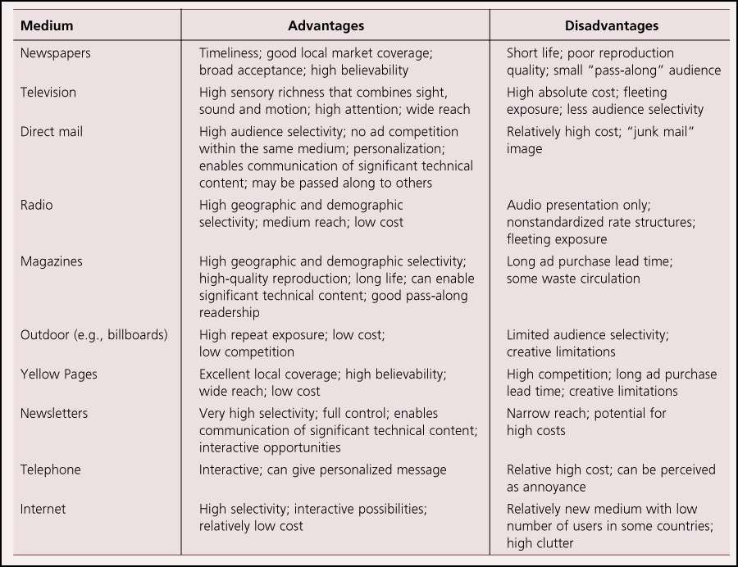
Marketing
Advantages and Disadvantages of Major Advertising Media

Slide 14
Marketing
Promotions
Temporary selling tactics that include:
Samples or free trial
Cash rebates after purchase
Including an additional product (a “premium”) with purchase
Incentives for repeat purchase
Sales bonuses to distributor or retailer sales representatives
Cross promotions between two or more non-competing products to increase pulling power
Point-of-purchase displays to demonstrate the product’s features
Publicity and Public Relations
Attempt to generate free publicity and word-of-mouth (e.g., mention in articles, television programs, etc.)
Produce own internally generated publications
Sponsor special events
Notes:
Promotions are temporary selling tactics used at the customer or distributor level to stimulate purchase or trial. Examples include:
Offering samples or free trial.
Offering cash rebates after purchase.
Including an additional product with purchase.
Offering sales bonuses to distributor or retailer sales representatives.
Publicity and Public Relations can be used to generate word-of-mouth recommendations, public awareness and goodwill.

Slide 15
Theory In Action
Generating Awareness for Domosedan
Farmos wanted to build awareness of its new innovation in animal painkillers.
Asked university professors and advanced practitioners to help with testing process for drug – acted as premarketing tool.
Drug was featured in conferences, articles, dissertations.
Farmos also hosted a large dinner party for all practicing veterinarians at the drug’s launch.
Domosedan was adopted rapidly around the world and became a commercial success.

Slide 16
Marketing
Tailoring the Marketing Plan to Intended Adopters
Innovators and Early Adopters respond to marketing that offers significant technical content and emphasizes leading-edge nature of product.
Need media with high content and selective reach
Early Majority responds to marketing emphasizing product’s completeness, ease o fuse, consistency with customer’s life, and legitimacy.
Need media with high reach and high credibility
Late Majority and Laggards respond to marketing emphasizing reliability, simplicity, and cost-effectiveness.
Need media with high reach, high credibility, but low cost.
Notes:
Tailoring the Marketing Plan to Intended Adopters is crucial because each adopter group responds to different marketing content. For example, early adopters usually respond to marketing materials emphasizing technical content and the leading edge nature of innovation. Later adopters respond to marketing materials that communicate a product’s completeness, ease of use, lifestyle match, and legitimacy. Transitioning from marketing to early adopters to late adopters may have to overcome some difficulties when the early majority is not yet convinced of technology’s utility.

Slide 17
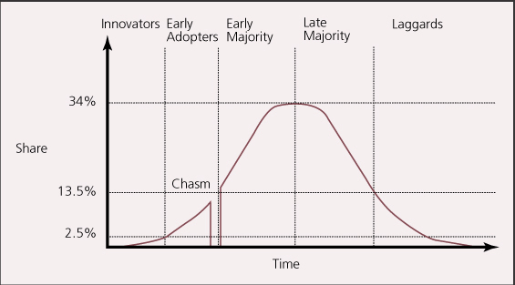
Marketing
Often hard to transition from selling to early adopters to early majority, resulting in “chasm.”

Slide 18
Marketing
Using Marketing to Shape Perceptions and Expectations
Perceptions and expectations of value can be as important as actual value. To influence, can use:
Preannouncements and press releases
Can build “mind share” in advance of actual market share
Can forestall purchases of competitors’ products
Reputation
Provides signal to market of likelihood of success
Credible commitments
Substantial irreversible investments can convince market of firm’s confidence and determination
Notes:
Creating an Information Epidemic
Certain individuals can have a disproportionate effect on the marketplace. Gladwell categorized these individuals into three categories:
Connectors have an exceptionally high number of diverse acquaintances, a high social drive, and are likely to bring together people that are otherwise unlikely to meet.
Mavens are driven to obtain and share knowledge about items of interest to them (product prices, attributes, etc.).
Salespersons are able to transmit verbal and nonverbal cues that enable them to influence other’s emotional responses and for our purposes purchasing decisions.
Using Marketing to Shape Perceptions and Expectations – Advertising, promotions and publicity will all play an important part in shaping the market’s expectations about the product, the installed base and the availability of complementary goods.
Preannouncements and Press Releases aggressively promoting existing and planned products can increase the actual and perceived installed base, both of which may drive future adoptions. “Vaporware” is the pre-advertising of products not yet on the market and are often used to encourage customers to wait for a firms product when a competitors product is already available.
Reputation (for introducing successful, well-supported innovations) will influence customers’, distributors’ and complementary goods producers’ expectations of the new product.
Credible Commitments including financial commitments to a new technology, either in R&D costs or in new manufacturing capability, will signal the market about the firm’s confidence in and commitment to the new product.

Slide 19
Deployment Tactics in the U.S. Video Game Industry
After the Atari/Coleco video game generation crashed, Nintendo was able to enter with an 8-bit system and rise to dominance by selling on consignment, alleviating retailers’ risk. It had a near monopoly from 1985-1989.
In 1989, Sega was able to overthrow Nintendo’s dominance by introducing a 16-bit system 1½ years before Nintendo.
Sony was able to break into the video game industry by introducing a 32-bit system, investing heavily in game development, and leveraging its massive clout with distributors.
In late 2001, Microsoft entered the video game industry with a 128-bit system. It had an advanced machine, and spent a lot on marketing and games, but Playstation2 already had an installed base of 20 million. The console did well, but never overtook Playstation2.
In late 2005, Microsoft was first to introduce the next generation console: Xbox 360. Nintendo’s Wii and Sony’s Playstation 3 would not debut until 2006. Both the Xbox 360 and Playstation 3 incorporated high definition DVD players, and were quite expensive. The Wii, on the other hand, was much simpler, and much cheaper, but had an innovative motion-sensing remote.
By February 2009, over 19 million Wiis had been sold, compared to 14.2 million Xbox 360s and 7 million Playstation 3s.
Notes:
19

Slide 20
Deployment Tactics in the U.S. Video Game Industry
Discussion Questions:
What factors do you think enabled Sega to break Nintendo’s near monopoly of the U.S. video game console market in the late 1980s?
Why did Nintendo choose to not make its video game consoles backward compatible? What were the advantages and disadvantages of this strategy?
What strengths and weaknesses did Sony have when it entered the video game market in 1995?
What strengths and weaknesses did Microsoft have when it entered the video game market in 2001?
Comparing the deployment strategies used by the firms in each of the generations, can you identify any timing, licensing, pricing, marketing, or distribution strategies that appear to have influenced firms’ success and failure in the video game industry?
Notes:
20

